Slide 1
Effect of clozapine on severe, therapy resistant self-harm and/or suicidality in adolescents
Wieteke Elzinga
Child and adolescent psychiatrist, GGZ Noord Holland Noord
PhD Candidate, LUMC Curium
Congres IHT en HIC Jongeren 24-9-2025

Slide 2
Experience clozapine adolescents
Literature
Broader clinical relevance and research
Notes:
Case of a 19-year-old female
Severe self-harm and suicidality
Multiple failed treatments
Clozapine led to major improvement
Broader clinical relevance

Slide 3

Binge eating and vomiting
Anorexia nervosa
Severe self-harm
Autism spectrum disorder, borderline traits
P PIQ 122, VIQ 98
Fasting
Major depressive disorder
Strong suicidal thoughts and actions
Bulimia nervosa
19 years old
Notes:
Anorexia nervosa
Major depressive disorder
Autism spectrum disorder
Her performance IQ was 122, and her verbal IQ 98.
Her symptoms changed a lot over time. She had periods of binge eating, vomiting, fasting, self-harming, and strong suicidal thoughts.

Slide 4








Referral
15 years old
1st admission
16 years old
Long-term psychiatric ward
19 years old:
An autonomy-promoting treatment approach without the use of coercion: high risk
28 sessions ECT
Medication: aripiprazole, olanzapine, risperidone, haldoperidol, fluoxetine, citalopram, nortrilen, benzodiazepines, lithium,
CBT, DBT
Notes:
First admission after 1 year
Long-term psychiatric ward
CBT, DBT
Medications: SSRIs, antipsychotics, benzodiazepines
No significant effect

Slide 5
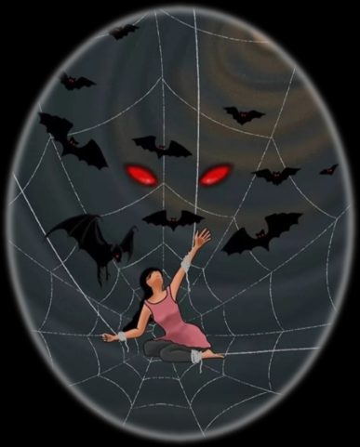

Slide 6











Consultation with colleagues
Consult an expert
Idea
Searching literature
Careful medical checks
Consultation with patient and parents
Start clozapine 300mg
Weighing the potential benefits and the associated risks

Slide 7



Daily dose of 300mg
Decrease in self-harm and suicide attempts
Practice moments at home
Lives at home a year later
FACT
Plasma level 349 ug/l

Slide 8
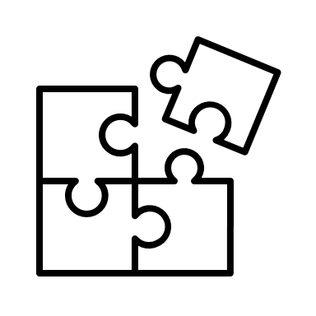


Current clinical challenge adolescent psychiatry
Clozapine?
Multiple psychiatric comorbidities
Severe self-harm and suicidality
Compulsory treatment
Loss of normal life experiences
Prolonged inpatient stays
Stagnation in development
Little to no treatment response
Predominantly female

Slide 9


Argent et al, 2014
Kumar et al, 2016
Case report
17-year-old female
Borderline personality disorder
Less aggression and self-harm after start clozapine
Small case serie
Two adolescents with non-psychotic disorders
Clozapine: reduce aggression, suicidal thoughts and self-injury
Not FDA-approved for pediatric use, off-label prescribed for early onset schizophrenia

Slide 10



6 female adolescents
Aged 13-21 years
Similar clinical profiles:
Severe suicidality and self-harm
Major depressive disorder
Eating disorder (5 in remission, 1 current)
Autism spectrum disorder
Medication:
At least 2 antipsychotics (commonly risperidone and olanzapine)
Two antidepressants
Most cases: lithium and ECT
All treated in locked inpatient settings

Slide 11


Doses: 100-250 mg/day
Level: 294-497 ug/l
Several adolescent were able to return home or live semi-independently after years of inpatient care
5/6
Reduction in self-harming urges and suicidal ideation
One adolescent showed no clinical improvement and died (no clozapine complication)
Variable reports of side effects
Frequent: daily fluctuations in leukocyte counts, without leukocytopenia
Weight gain varied significantly

Slide 12



Research

Slide 13


Workshop
Notes:
Wat heeft een behandelaar nodig om deze stap te overwegen en zo nodig te gaan uitvoeren?
Wat zijn belemmerende en wat zijn bevorderende factoren?

Slide 14
Thank you
Questions?
Feel free to connect
w.elzinga@ggz-nhn.nl

